Slide 1
Module – 6
Internet Protocol san and fibre channel over ethernet
Module 6: IP SAN and FCoE
1
Notes:
Module – 6
IP SAN and FCoE

Slide 2
Module 6: IP SAN and FCoE
Upon completion of this module, you should be able to:
  Describe IP SAN protocols, components, and topology
  Describe FCoE protocol, components, and topology

Slide 3
Module 6: IP SAN and FCoE
Lesson 1: IP SAN
During this lesson the following topics are covered:
  Drivers for IP SAN
  IP SAN Protocols: iSCSI and FCIP
  Components, topologies, and protocol stack for iSCSI and FCIP

Slide 4
Drivers for IP SAN
IP SAN transports block-level data over IP network
IP is being positioned as a storage networking option because:
  Existing network infrastructure can be leveraged
  Reduced cost compared to investing in new FC SAN hardware and software
  Many long-distance disaster recovery solutions already leverage IP-based network
  Many robust and mature security options are available for IP network

Slide 5
IP SAN Protocol: Internet Small Computer System Interface (iSCSI)
IP based protocol that is used to connect host and storage
Encapsulates SCSI commands and data into an IP packet and transports them using TCP/IP

Slide 6
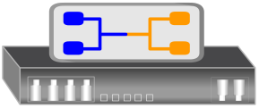
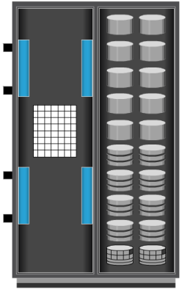
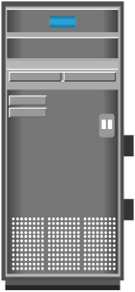

Components of iSCSI
iSCSI initiator
  Example: iSCSI host bus adapter (HBA)
iSCSI target
  Storage array with iSCSI port
  iSCSI gateway – enables communication with FC storage array
IP network
iSCSI Gateway
Storage Array
Server
IP
FC Port
iSCSI HBA
iSCSI Port
Storage Array

Slide 7
iSCSI Host Connectivity Options
Standard NIC with software iSCSI initiator
  NIC provides network interface
  Software initiator provides iSCSI functionality
  Requires host CPU cycles for iSCSI and TCP/IP processing
TCP Offload Engine (TOE) NIC with software iSCSI initiator
  Moves TCP processing load off the host CPU onto the NIC card
  Software initiator provides iSCSI functionality
  Requires host CPU cycles for iSCSI processing
iSCSI HBA
  Offloads both iSCSI and TCP/IP processing from host CPU
  Simplest option for boot from SAN

Slide 8
iSCSI Topologies: Native iSCSI
iSCSI initiators are either directly attached to storage array or connected through IP network
  No FC component
  Storage array has iSCSI port
Each iSCSI port is configured with an IP address
IP
Server
Storage Array
iSCSI HBA
iSCSI Port

Slide 9

iSCSI Topologies: Bridged iSCSI
iSCSI gateway is used to enable communication between iSCSI host and FC storage
iSCSI gateway works as bridge between FC and IP network
  Converts IP packets to FC frames and vice versa
iSCSI initiator is configured with gateway’s IP address as its target
iSCSI gateway is configured as FC initiator to storage array
iSCSI Gateway
IP
Server
iSCSI HBA
FC SAN
Storage Array
Server
FC HBA
FC Port

Slide 10
Combining FC and Native iSCSI Connectivity
Array provides both FC and iSCSI ports
  Enable iSCSI and FC connectivity in the same environment
  No bridge devices needed
iSCSI Port
IP
Server
iSCSI HBA
FC SAN
Storage Array
FC Port
Server
FC HBA

Slide 11
iSCSI Protocol Stack
Ethernet
IP
TCP
iSCSI

Slide 12
iSCSI Discovery
For iSCSI communication, initiator must discover location and name of target on a network
iSCSI discovery takes place in two ways:
  SendTargets discovery
    Initiator is manually configured with the target’s network portal
    Initiator issues SendTargets command; target responds with required parameters
  Internet Storage Name Service (iSNS)
    Initiators and targets register themselves with iSNS server
    Initiator can query iSNS server for a list of available targets

Slide 13
iSCSI Name
iSCSI name is a unique iSCSI identifier that is used to identify initiators and targets within an iSCSI network
Two common types of iSCSI names are:
  iqn: iSCSI Qualified Name
    iqn.2008-02.com.example:optional_string
  eui: Extended Unique Identifier
    eui.0300732A32598D26

Slide 14
IP SAN Protocol: FCIP
IP-based protocol that is used to connect distributed FC SAN islands
Creates virtual FC links over existing IP network that is used to transport FC data between different FC SANs
Encapsulates FC frames onto IP packet
Provides disaster recovery solution

Slide 15
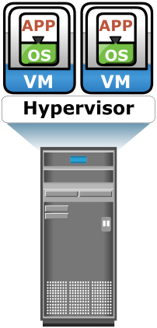
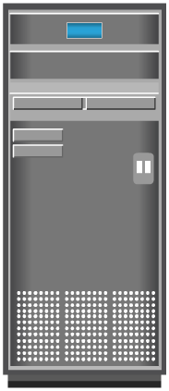
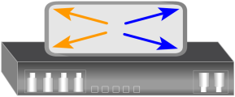
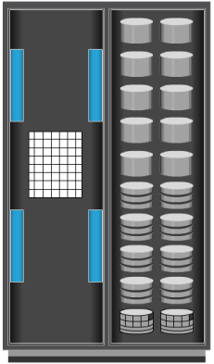
FCIP Topology
Servers
Servers
Server
Server
FCIP Gateway
FCIP Gateway
FC SAN
FC SAN
IP
Storage Array
Storage Array

Slide 16
FCIP Protocol Stack
IP
TCP
FCIP
Header
Header
Header

Slide 17
Module 6: IP SAN and FCoE
Lesson 2: Fibre Channel over Ethernet (FCoE)
During this lesson the following topics are covered:
  Drivers for FCoE
  Components of FCoE network
  FCoE frame mapping
  Converged Enhanced Ethernet (CEE)

Slide 18
Drivers for FCoE
FCoE is a protocol that transports FC data over Ethernet network (Converged Enhanced Ethernet)
FCoE is being positioned as a storage networking option because:
  Enables consolidation of FC SAN traffic and Ethernet traffic onto a common Ethernet infrastructure
  Reduces the number of adapters, switch ports, and cables
  Reduces cost and eases data center management
  Reduces power and cooling cost, and floor space

Slide 19
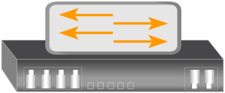
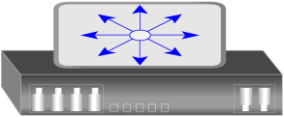
Data Center Infrastructure – Before Using FCoE
Servers
Servers
Server
Server
FC
Switches
IP
Switches
FC
Switches
LAN
Storage Array
Storage Array

Slide 20
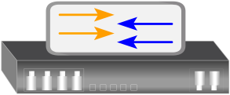
Data Center Infrastructure – After Using FCoE
Servers
Servers
Server
Server
FCoE
Switches
FC
Switches
LAN
Storage Array
Storage Array

Slide 21
Components of an FCoE Network
Converged Network Adapter (CNA)
Cable
FCoE switch

Slide 22
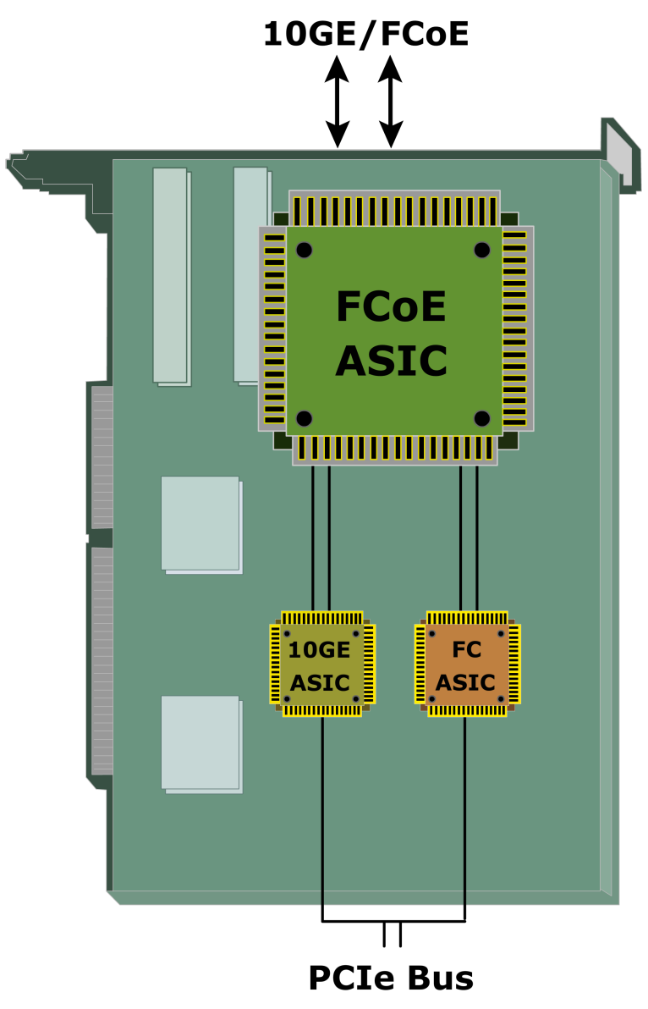
Converged Network Adapter (CNA)
Provides functionality of both – a standard NIC and an FC HBA
  Eliminates the need to deploy separate adapters and cables for FC and Ethernet communications
Contains separate modules for 10 Gigabit Ethernet, FC, and FCoE Application Specific Integrated Circuits (ASIC)s
  FCoE ASIC encapsulates FC frames into Ethernet frames

Slide 23
Cable
Two options are available for FCoE cabling
  Copper based Twinax cable
  Standard fiber optical cable
Twinax Cable | Fiber Optical Cable
Suitable for shorter distances (up to 10 meters) | Can run over longer distances
Requires less power and are less expensive than fiber optical cable | Relatively more expensive than Twinax cables
Uses Small Form Factor Pluggable Plus (SFP+) connector | Uses Small Form Factor Pluggable Plus (SFP+) connector

Slide 24
FCoE Switch
Provides both Ethernet and FC switch functionalities
Consists of FCF, Ethernet bridge, and set of CEE ports and FC ports (optional)
  FCF encapsulates and de-encapsulates FC frames
Forwards frames based on Ethertype
  Used to indicate which protocol is encapsulated in the payload of an Ethernet frame
FC Port
FC Port
FC Port
FC Port
Fibre Channel Forwarder (FCF)
Ethernet Bridge
Ethernet
Ethernet
Ethernet
Ethernet
Port
Port
Port
Port

Slide 25
FCoE Frame Mapping
OSI Stack
7 - Application
FCoE Protocol Stack
FC Protocol Stack
6 - Presentation
FC - 4
FC - 4 Protocol map
5 - Session
FC Layers
FC - 3
FC - 3 Services
4 - Transport
FC - 2
FC - 2 Framing
3 - Network
FCoE Mapping
FC - 1 Data enc/dec
2 - Data Link
IEEE 802.1q
2 - MAC
FC - 0 Physical
Layers
1 - Physical
1 - Physical
Ethernet

Slide 26
Converged Enhanced Ethernet
Provides lossless Ethernet
Lossless Ethernet requires following functionalities:
  Priority-based flow control (PFC)
  Enhanced transmission selection (ETS)
  Congestion notification (CN)
  Data center bridging exchange protocol(DCBX)

Slide 27
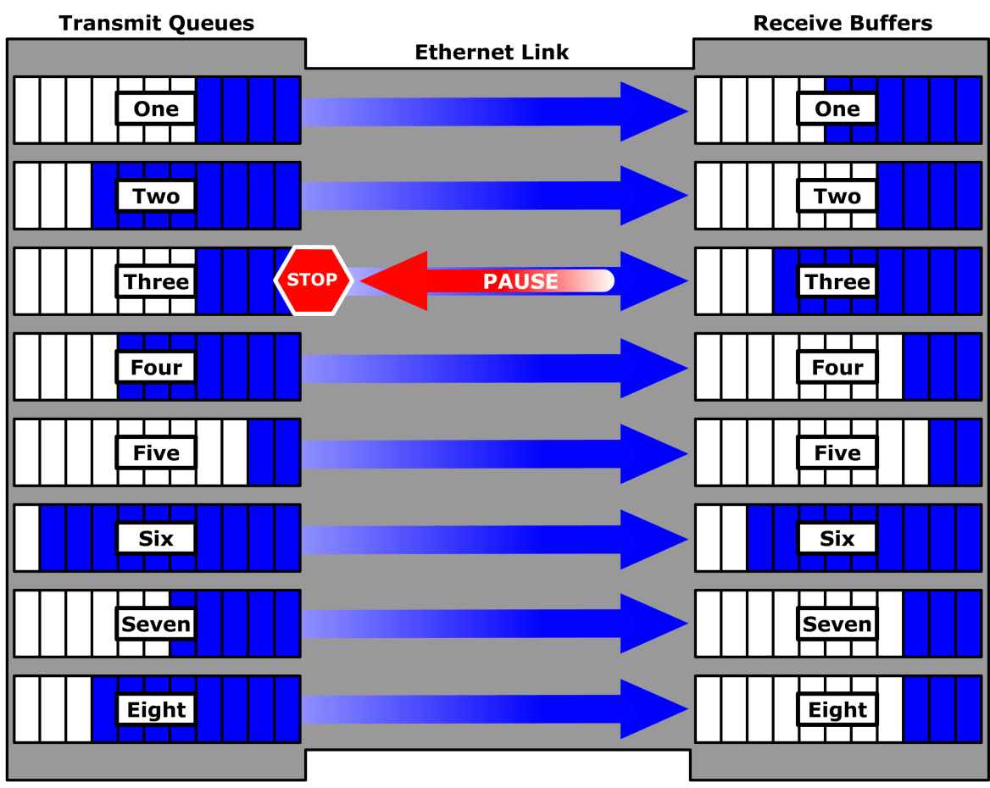
  Priority-Based Flow Control (PFC)
Creates eight virtual links on a single physical link
Uses PAUSE capability of Ethernet for each virtual link
  A virtual link can be paused and restarted independently
  PAUSE mechanism is based on user priorities or classes of service

Slide 28
Enhanced Transmission Selection (ETS)
Allocates bandwidth to different traffic classes such as LAN, SAN, and Inter Process Communication (IPC)
Provides available bandwidth to other classes of traffic when a particular class of traffic does not use its allocated bandwidth

Slide 29
  Congestion Notification (CN)
Provides a mechanism for detecting congestion and notifying the source
  Enables a switch to send a signal to other ports that need to stop or slow down their transmissions
Rate limiting to avoid
packet loss
FCoE
Switch
FCoE
Switch
FCoE
Switch
Host
(Node A)
Congestion
Notification Message
Congestion
Storage Array
(Node B)

Slide 30
  Data Center Bridging Exchange Protocol (DCBX)
Enables CEE devices to convey and configure their features with other CEE devices in the network
  Allows a switch to distribute configuration values to attached adapters
Ensures consistent configuration across network

Slide 31
Module 6: Summary
Key points covered in this module:
IP SAN protocols, their components, and topologies
FCoE protocol, its components, and topology

